Slide 1
ES 200: Summer 2019-2020
Environmental Studies : Science and Engineering
Module C: Solid Waste Management
Prof Tabish Nawaz (Module C)
(tnawaz@iitb.ac.in)
Environmental Science and Engineering Dept.,
IIT Bombay
* Instructor In-Charge
(vsethi@iitb.ac.in)

Slide 2

Module B
Solid Waste Management
Lecture-2 Appendix
Example problem
Chemical formula of waste
Energy content estimation
Typical data for energy content
References
Sincero, A.P., Sincero, G.A., Environmental Engineering: A design Approach, Ecology & Environmental Studies, 2006, PHI, Delhi
Peavy, H.S., Rowe, D.R., Tchobanoglous, G., Environmental Engineering, 2013, McGraw Hill, Delhi

Slide 3
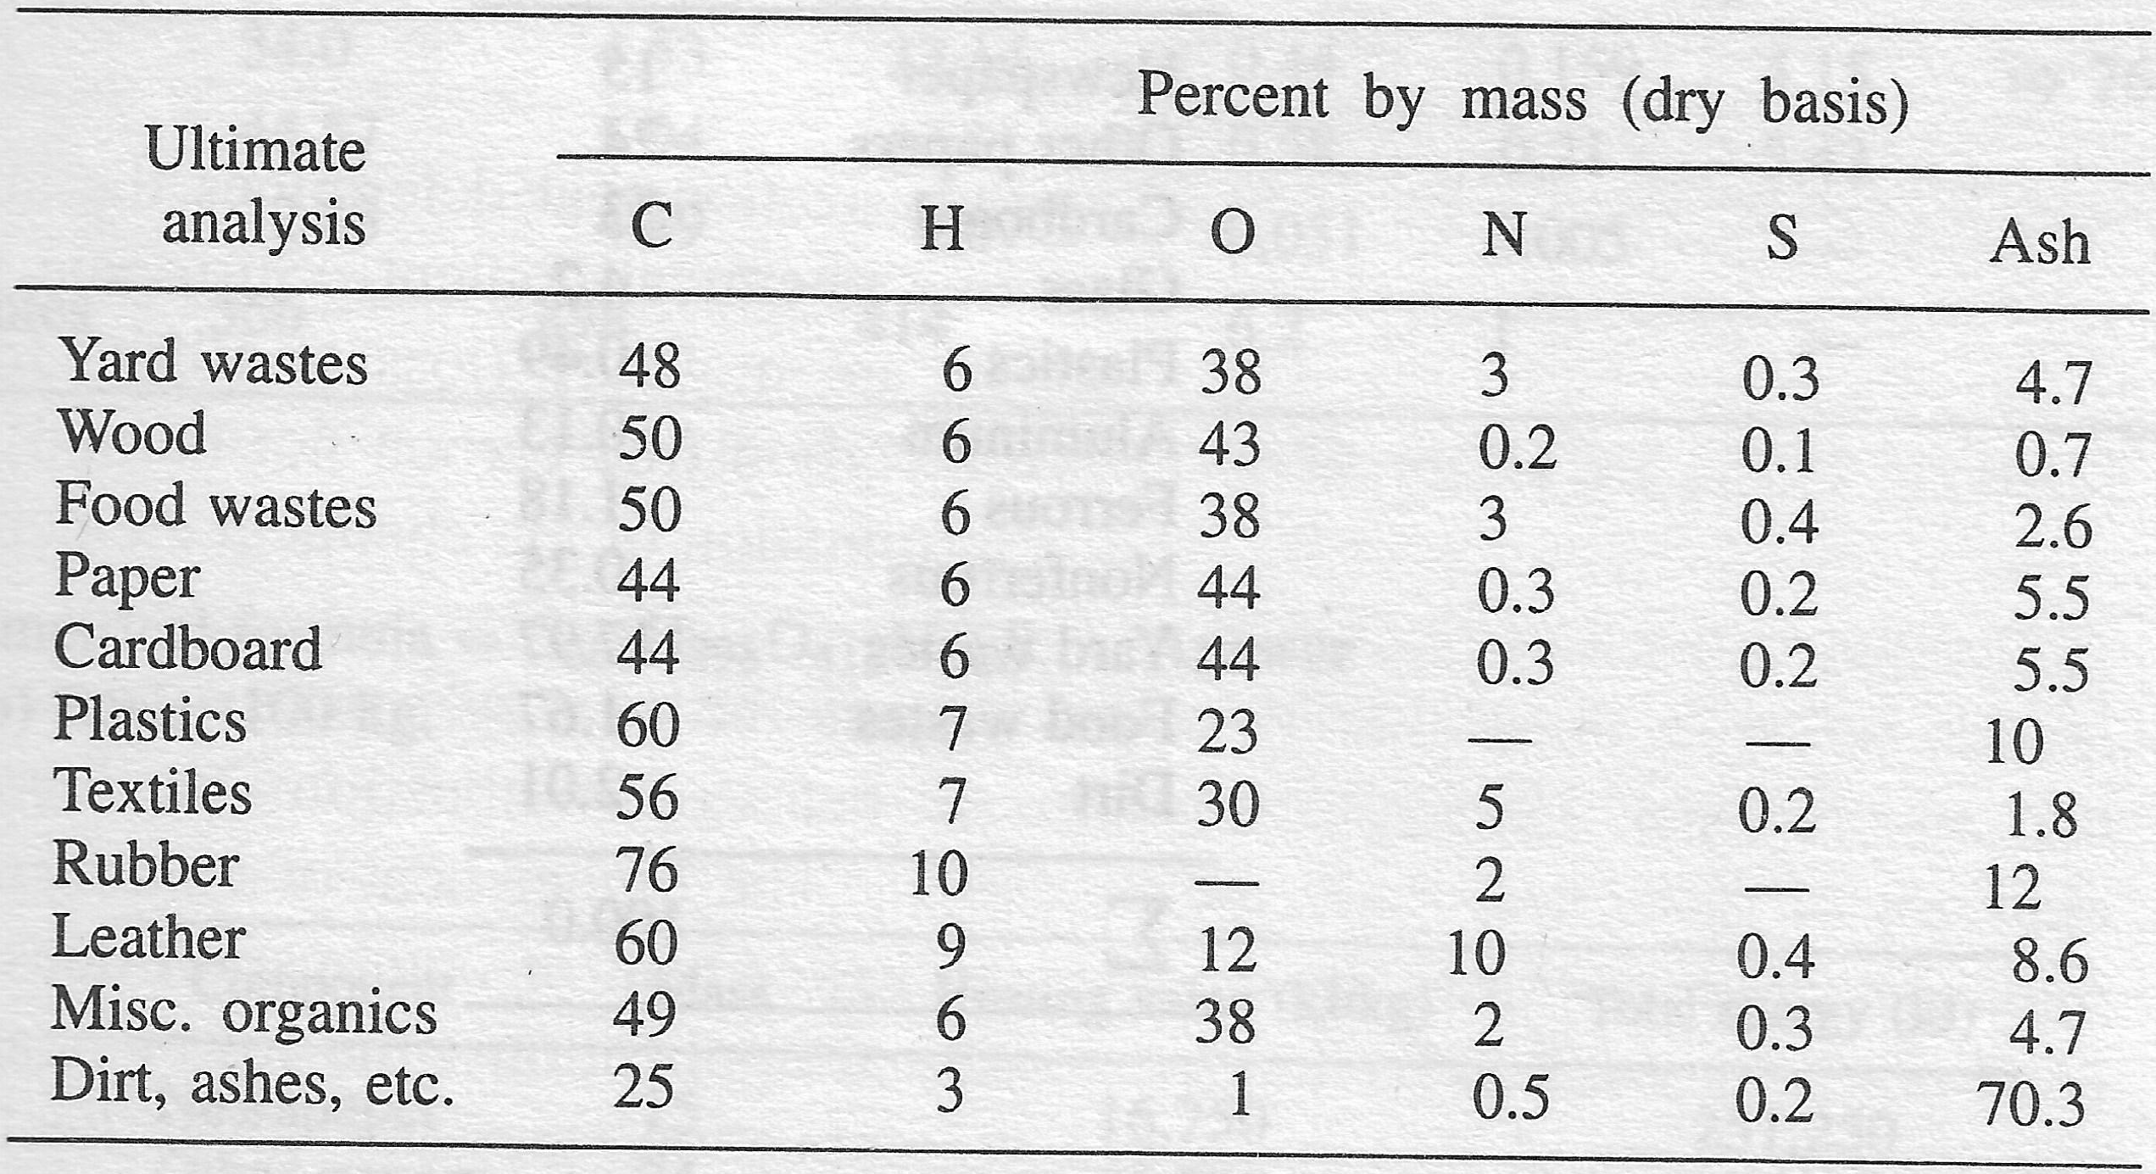
Example Problem
Derive an empirical organic formula and find the higher heating value for the solid waste sample shown below, and given are the results from ultimate analysis of typical MSW components.
Component | Mass (%) | Moisture (%)
Newspaper | 15 | 6.0
Other papers | 24 | 6.0
Cardboard | 33 | 5.0
Glass | 4.2 | 0.5
Plastics | 0.49 | 2.0
Aluminum | 0.13 | 0.5
Ferrous | 1.18 | 0.5
Nonferrous | 0.35 | 0.5
Yard waste | 17.97 | 60
Food waste | 1.67 | 60
Dirt | 2.01 | 8.0
∑ | 100
Results from ultimate analysis

Slide 4
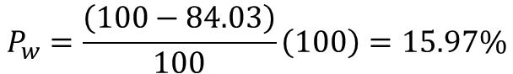
Example Problem
Step 1: Calculate dry-mass of each component for 100 kg basis
(e.g. (1 - 0.06) x 15 = 14.10)
Component | Mass (%) | Moisture (%) | Dry mass (kg)
Newspaper | 15 | 6.0 | 14.10
Other papers | 24 | 6.0 | 22.56
Cardboard | 33 | 5.0 | 31.35
Glass | 4.2 | 0.5 | 4.18
Plastics | 0.49 | 2.0 | 0.48
Aluminum | 0.13 | 0.5 | 0.13
Ferrous | 1.18 | 0.5 | 1.17
Nonferrous | 0.35 | 0.5 | 0.35
Yard waste | 17.97 | 60 | 7.19
Food waste | 1.67 | 60 | 0.67
Dirt | 2.01 | 8.0 | 1.85
∑ | 100 |  | 84.03
$$P_{w}=\frac{\left(100−84.03\right)}{100}\left(100\right)=15.97\%$$

Slide 5
Example Problem
Step 2: Based on dry-mass and results from the ultimate analysis, calculate the mass elemental composition
(e.g. 14.10 x 0.44 “C” from ultimate analysis = 6.204)
Component | Dry mass (kg) | C | H | O | N | S | Ash
Newspaper | 14.10 | 6.204 | 0.846 | 6.204 | 0.042 | 0.028 | 0.776
Other papers | 22.56 | 9.926 | 1.354 | 9.926 | 0.068 | 0.045 | 1.241
Cardboard | 31.35 | 13.794 | 1.881 | 13.794 | 0.094 | 0.063 | 1.724
Glass | 4.18 | - | - | - | - | - | -
Plastics | 0.48 | 0.288 | 0.034 | 0.110 | - | - | 0.048
Aluminum | 0.13 | - | - | - | - | - | -
Ferrous | 1.17 | - | - | - | - | - | -
Nonferrous | 0.35 | - | - | - | - | - | -
Yard waste | 7.19 | 3.450 | 0.431 | 2.731 | 0.216 | 0.022 | 0.338
Food waste | 0.67 | 0.334 | 0.040 | 0.254 | 0.020 | 0.003 | 0.017
Dirt | 1.85 | - | - | - | - | - | -
∑ | 84.03 | - | - | - | - | - | -
* Excluded glass, aluminum, ferrous, nonferrous and dirt in the organic calculation

Slide 6
Example Problem
Step 3: Calculate the mass and molar fraction for each element
(e.g. 6.2 + 9.93 + 13.79 + 0.288 + 3.45 + 0.34 = 34; 34/76.35 = 44.5%
Making the lowest constituent (S) a unit; 5/5 = as the division factor)
Component | Dry mass (kg) | C | H | O | N | S | Ash
Newspaper | 14.10 | 6.204 | 0.846 | 6.204 | 0.042 | 0.028 | 0.776
Other papers | 22.56 | 9.926 | 1.354 | 9.926 | 0.068 | 0.045 | 1.241
Cardboard | 31.35 | 13.794 | 1.881 | 13.794 | 0.094 | 0.063 | 1.724
Plastics | 0.48 | 0.288 | 0.034 | 0.110 | - | - | 0.048
Yard waste | 7.19 | 3.450 | 0.431 | 2.731 | 0.216 | 0.022 | 0.338
Food waste | 0.67 | 0.334 | 0.040 | 0.254 | 0.020 | 0.003 | 0.017
∑ mass | 76.35 | 34.00 | 4.59 | 33.02 | 0.44 | 0.16 | 4.14
% mass |  | 44.5% | 6.01% | 43.3% | 0.58% | 0.21% | 5.43%
∑ moles |  | 2833 | 4586 | 2064 | 31.43 | 5 | -
adjusted moles |  | 566 | 916 | 412 | 6.3 | 1 | -
Empirical organic formula for the solid waste = C₅₆₆ H₉₁₆ O₄₁₂ N_{6.3} S

Slide 7
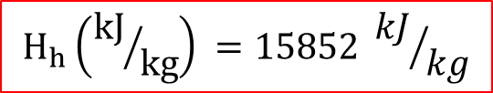
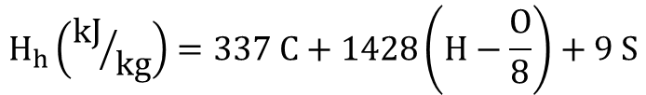
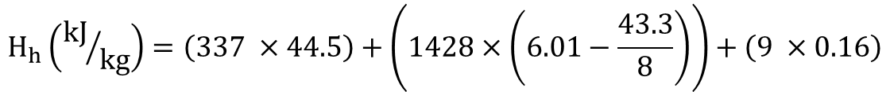
Example Problem
Step 4: Calculate the higher heating value using modified Dulong formula
Component | Dry mass (kg) | C | H | O | N | S | Ash
Newspaper | 14.10 | 6.204 | 0.846 | 6.204 | 0.042 | 0.028 | 0.776
Other papers | 22.56 | 9.926 | 1.354 | 9.926 | 0.068 | 0.045 | 1.241
Cardboard | 31.35 | 13.794 | 1.881 | 13.794 | 0.094 | 0.063 | 1.724
Plastics | 0.48 | 0.288 | 0.034 | 0.110 | - | - | 0.048
Yard waste | 7.19 | 3.450 | 0.431 | 2.731 | 0.216 | 0.022 | 0.338
Food waste | 0.67 | 0.334 | 0.040 | 0.254 | 0.020 | 0.003 | 0.017
∑ mass | 76.35 | 34.00 | 4.59 | 33.02 | 0.44 | 0.16 | 4.14
% mass |  | 44.5% | 6.01% | 43.3% | 0.58% | 0.21% | 5.43%
$$H_{h}\left({kJ}/{kg}\right)=337 C+1428\left(H−\frac{O}{8}\right)+9 S$$
$$H_{h}\left({kJ}/{kg}\right)=\left(337 ×44.5\right)+\left(1428×\left(6.01−\frac{43.3}{8}\right)\right)+\left(9 ×0.16\right)$$
$$H_{h}\left({kJ}/{kg}\right) =15852 {kJ}/{kg}$$

Slide 8
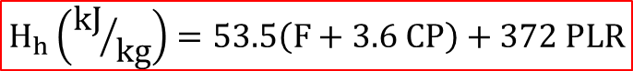

Example Problem
Step 5: Compare the values obtained by using the approximate formula
Component | Mass fraction(%) | Dry mass (kg) | Dry Mass fraction (%)
Newspaper | 15 | 14.10 | 16.78%
Other papers | 24 | 22.56 | 26.85%
Cardboard | 33 | 31.35 | 37.31%
Glass | 4.2 | 4.18 | 4.97%
Plastics | 0.49 | 0.48 | 0.57%
Aluminum | 0.13 | 0.13 | 0.15%
Ferrous | 1.18 | 1.17 | 1.40%
Nonferrous | 0.35 | 0.35 | 0.41%
Yard waste | 17.97 | 7.19 | 8.55%
Food waste | 1.67 | 0.67 | 0.79%
Dirt | 2.01 | 1.85 | 2.20%
∑ | 100 | 84.03
F (food waste) = 0.79; CP (cardboard and paper) = 37.31 + 26.85 + 16.78;
PLR = 0.57 (assuming leather and rubber ~ 0)
$$H_{h}\left({kJ}/{kg}\right)=53.5\left(F+3.6 CP\right)+372 PLR$$
$$H_{h}\left({kJ}/{kg}\right) =15844 {kJ}/{kg}$$

Slide 9
Typical data on inert residue and energy content of municipal solid waste components
Energy values based on as-discarded basis

Slide 10


Example Problem
Step 6: Compare the values obtained by using the typical literature data
Component | Mass fraction | Typical Heating Value (kJ/kg) | Energy (kJ)
Newspaper | 15 | 16750 | 251,250
Other papers | 24 | 16750 | 402,000
Cardboard | 33 | 16300 | 537,900
Plastics | 0.49 | 32600 | 15,974
Yard waste | 17.97 | 6500 | 116,805
Food waste | 1.67 | 4650 | 7,766
Glass | 4.20 | 150 | 630
Ferrous | 1.18 | 700 | 826
Dirt | 2.01 | 7000 | 14,070
∑ | 99.52 |  | 1,347,221
 |  | Energy Content (as-discarded) | 13,537
$$H_{h} \left(dry basis\right)\left({kJ}/{kg}\right)=H_{h} \left(as discarded\right)\left({kJ}/{kg}\right)\left(\frac{100}{100−P_{w}}\right)$$
$$H_{h}\left({kJ}/{kg}\right) =16110 {kJ}/{kg}$$

